Slide 1
Source of income Discrimination
How Oregon’s source-of-income law affected housing choice voucher outcomes.

Slide 2
Background: Housing choice vouchers (HCVs)
The housing choice vouchers program (aka Section 8 housing) provides vouchers for low-income families, the elderly, and disabled people.
One goal is for participants to move to a low-poverty area. However, with a few exceptions, landlords do not have to accept vouchers under federal law.
Oregon passed a source-of-income law (SOI) in 2013, prohibiting landlords from rejecting tenants solely for using vouchers. (CBPP 2018)
The law penalized landlords for discrimination but also compensated them if the suffered damages. This second prevision was later amended. (Dietz 2017)

Slide 3
Central question: Has Oregon’s SOI law improved neighborhood quality for HCV users?
Did the SOI law increase the percentage of voucher users in low-poverty neighborhoods?
Census tracks are used as proxies for neighborhoods.
For our purposes, low-poverty is defined as 0 – 9%.
Our period of study will be 2009 to 2019, sans 2011.

Slide 4
Why does this matter?
There has also been an effort in recent years to pass SOI laws:
Washington (2018)
New York (2019)
Maryland (2020)
California* (2020)
Some jurisdictions, such as Texas, have expressly prohibited municipalities from passing SOI laws (2015). (Tighe et al. 2017) Other states have had SOI laws on the books for decades.
Furthermore, housing will be one of the most pressing issues in policymakers’ minds for foreseeable future due to Covid-19 fallout.

Slide 5
Existing literature and contribution
Martha Galvez in her PhD dissertation (2011), found that “average neighborhood poverty rates for voucher holders were slightly lower in areas with source of income antidiscrimination laws in place”.
Freeman and Li (2014) examined various cities using diff-in-diff estimation, finding reductions in neighborhood poverty rates and minority concentration resulting from passing SOI laws.
While this study explores a similar question as Freeman and Li, it is still a question worth investigating given the over all lack of research in this area. Furthermore, we will be using a synthetic control approach rather than a case study approach.

Slide 6
Data
Pooled household-level data from HUD via public use microdata sample (PUMS). Unfortunately, the data does not have information on specific census tracts a voucher participant corresponds to.
Census-tract-level data from HUD’s Picture of Subsidized Households, which includes poverty rates, number of households/individuals but it does not have a household-level data.

Slide 7
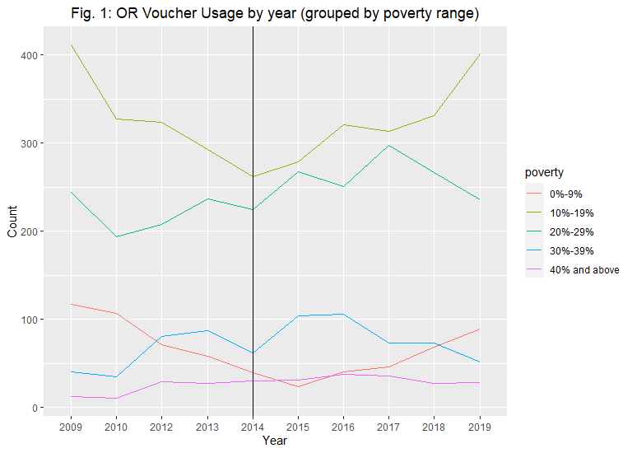
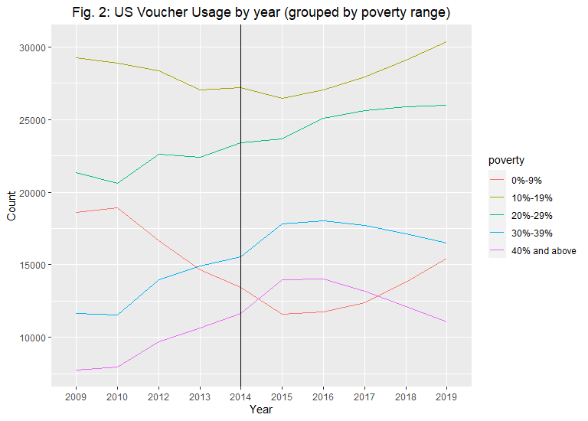
Voucher Usage across time and geographies

Slide 8
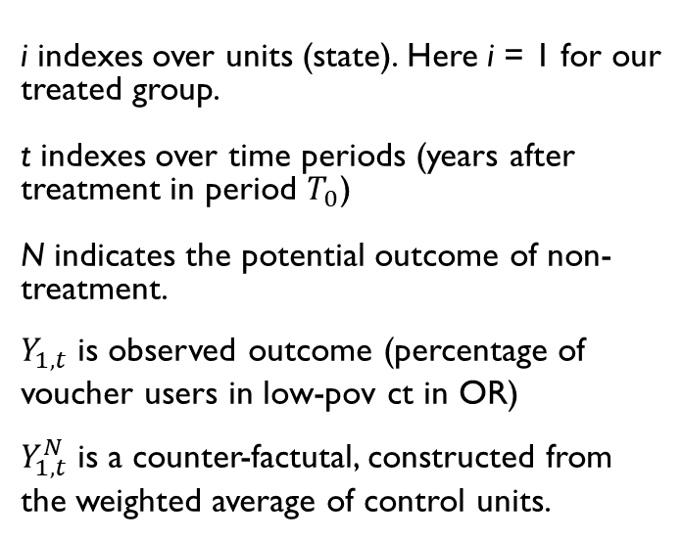
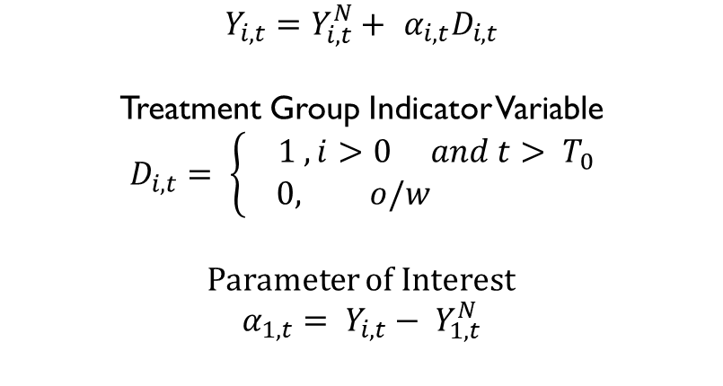
Identification and Methodology
Synthetic Control Estimation
i indexes over units (state). Here i = 1 for our treated group.
t indexes over time periods (years after treatment in period $T_{0}$)
N indicates the potential outcome of non-treatment.
$Y_{1,t}$ is observed outcome (percentage of voucher users in low-pov ct in OR)
$Y_{1, t}^{N}$ is a counter-factutal, constructed from the weighted average of control units.
$$Y_{i, t}=Y_{i,t}^{N}+ {α_{i,t}D}_{i,t}$$
Treatment Group Indicator Variable
$$D_{i,t}= \left\{\begin{aligned}1 , i>0 &&&and t> T_{0} \\ 0, o/w\end{aligned}\right.$$
Parameter of Interest
$$α_{1,t}= Y_{i,t}− Y_{1, t}^{N}$$

Slide 9
Challenges and potential remedies
Poverty rates in census tracts are not constant over time, meaning that measuring there may be some spurious correlation with our outcome of interest.
Finding a way to link PUMS and PSH data sets may help the power of our model.
Synthetic Control requires a long lead up to the treatment date, but we are missing data for 2011 and data prior to 2012 uses different census tract designations.
We would have to limit the data to 2012 – 2019, or make assumptions to make the data better fit the model.

Slide 10
References
https://www.cbpp.org/sites/default/files/atoms/files/10-10-18hous.pdf, accessed Oct. 2020.
https://www.hud.gov/topics/housing_choice_voucher_program_section_8, accessed Oct. 2020.
Dietz, Diane. “Marion County landlords adept at tapping state fund” Statesman Journal, accessed Oct. 2020.
Tighe, Rosie, Megan Hatch, Joseph Mead. 2017. “Source of Income Discrimination and Fair Housing Policy,” Journal of Planning Literature,32(1) 3-15.
Freeman, Lance, Yunjing Li. 2014. “Do Source of Income Anti-Discrimination Laws Facilitate Access to Less Disadvantaged Neighborhoods?” Housing Studies 29(1) 88 – 107.
Galvez, Martha. 2011. “Defining ‘Choice’ in the Housing Choice Voucher Program: The Role of Market Constraints and Household Preferences in Location Outcomes” (UMI Number 3459703) [Doctoral dissertation, University of New York]. UMI Dissertation Publishing.
https://www.huduser.gov/portal/pumd/home.html, accessed Oct. 2020
https://www.huduser.gov/portal/datasets/assthsg.html, accessed Nov. 2020.
Abadie, Alberto, Alexis Diamond, Jens Hainmueller. 2010. “Synthetic Control Methods for Comparative Case Studies: Estimating the Effect of California’s Tobacco Control Program” Journal of American Statistical Association 105 (490), 493 – 505.

